Slide 1
PORT A
PORT B
data_a
data_b
addr_a
addr_b
64x8-bit SRAM
wrt_b
wrt_a
clk
clk
out_a
out_b
Dual-Port RAM

Slide 2
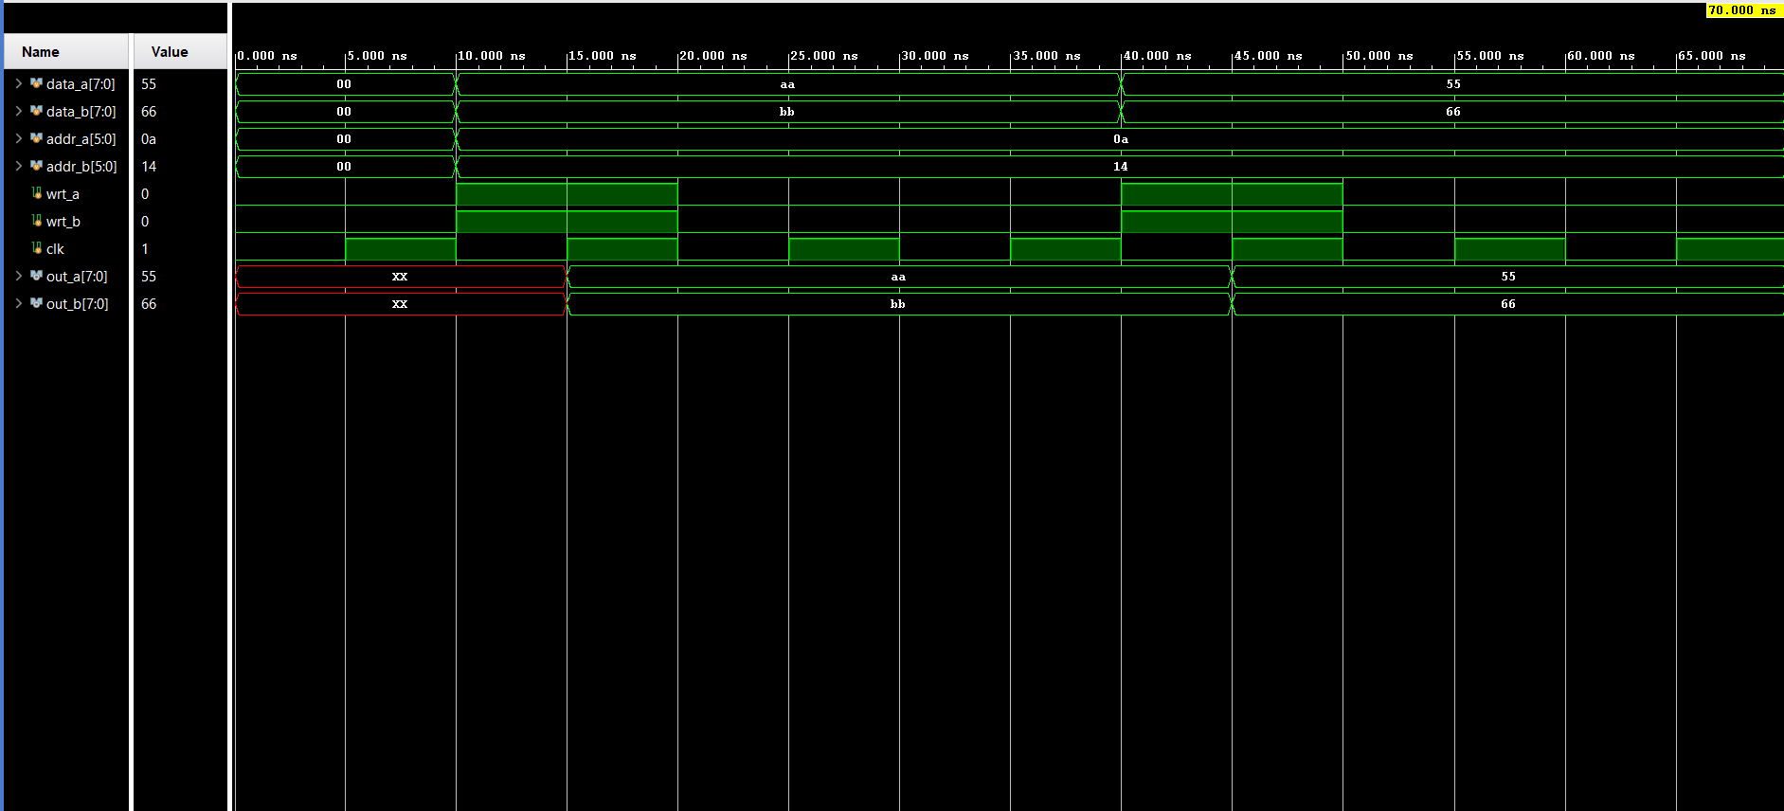

Slide 3
